Slide 1

Programming in Python with AI
IILM
UNIVERSITY
School of Computer Science and Engineering
Internship / Training Presentation
Student: Charu Arora
Roll Number: 2410030544
Program: B.Tech (CSE)
14 MARCH 2026
Batch: 2026–27
Training: 6-week online training

Slide 2
Candidate & Program Overview
2
Personal and academic details
Candidate
CHARU ARORA
Roll Number: 2410030544
Training Title
Programming in Python with AI
• Introduction to Python
• Programming fundamentals and variables
• Object-oriented programming
• SQLite database connectivity
• GUI development with PyQt
• Applications of Python across disciplines
• AI in programming with Python
• Final project component
Academic Program
B.Tech (Computer Science & Engineering)
Batch: 2026–27
Training Format
6-week online training
Institution
IILM University
Greater Noida, U.P.
Certification
14 March 2026 • Top performer

Slide 3
Training Overview
3
What the six-week training covered
Foundation
The training begins with Python as a programming language, variables, basic programming concepts and logical problem solving.
Application Development
The curriculum introduces OOP, SQLite database connectivity and GUI development using PyQt.
AI Exposure
The certificate includes AI in Programming with Python, alongside applications of Python in various disciplines.
• Duration: 6-week online training
• Certification date: 14 March 2026
• Certificate identifies Charu Arora as a top performer
• The certificate does not specify detailed weekly dates or a separate project title.
CHARU ARORA • PROGRAMMING IN PYTHON WITH AI • IILM UNIVERSITY

Slide 4
Core Learning Objectives
4
Objectives derived from the certified module list
Python Fundamentals
Understand Python and become familiar with its basic syntax and programming concepts.
Variables & Logic
Use variables to represent values and build a foundation in program logic.
OOP
Understand principles of object-oriented programming and structured code.
01
02
03
SQLite
Learn the concept of connecting Python applications to a database.
GUI Development
Explore graphical user interface development using PyQt.
AI with Python
Gain introductory exposure to AI-oriented programming with Python.
04
05
06
CHARU ARORA • PROGRAMMING IN PYTHON WITH AI • IILM UNIVERSITY

Slide 5
Technologies & Concepts Covered
5
Tools and learning areas explicitly represented in the report
Programming
Python
Core Concepts
Variables • Basic programming • Program logic
Programming Paradigm
Object-Oriented Programming (OOP)
Database
SQLite
GUI Development
PyQt
Application Areas
Python applications in various disciplines
AI Learning
AI in Programming with Python
Training Activity
Final Project component
CHARU ARORA • PROGRAMMING IN PYTHON WITH AI • IILM UNIVERSITY

Slide 6
Training Curriculum & Modules
6
Module-wise presentation — the certificate does not provide a week-by-week schedule
Introduction to Python
Introduction to Python as a programming language.
Using Variables in Python
Representing and manipulating values.
Basics of Programming in Python
Core programming concepts and program logic.
Principles of Object-oriented Programming (OOP)
Object-oriented concepts and structured code.
Connecting to SQLite Database
Database connectivity and persistent data storage.
Developing a GUI with PyQt
Graphical interfaces and desktop application interaction.
Application of Python in Various Disciplines
Python's versatility across application areas.
AI in Programming with Python
Introductory AI-related programming concepts.
The Final Project
Final project component; specific topic/results not stated.
CHARU ARORA • PROGRAMMING IN PYTHON WITH AI • IILM UNIVERSITY

Slide 7
Learning Approach
7
Conceptual progression represented by the training modules
Learn
Python basics, variables and programming logic
Structure
Apply OOP concepts to organize code
Connect
Use SQLite when applications require stored data
01
02
03
Interact
Explore GUI development with PyQt
Extend
Consider Python applications across disciplines and AI
Apply
Bring relevant concepts together in the final project
04
05
06
CHARU ARORA • PROGRAMMING IN PYTHON WITH AI • IILM UNIVERSITY

Slide 8
Key Learning Outcomes
8
Learning areas supported by the certified curriculum
• A foundation in Python programming and the use of variables.
• Familiarity with basic programming logic and structured problem solving.
• Introductory understanding of object-oriented programming principles.
• Awareness of Python connectivity with an SQLite database.
• Familiarity with GUI development concepts using PyQt.
• Awareness of Python's applications in different disciplines.
• Introductory exposure to AI-related programming with Python.
• Completion of the final project component included in the curriculum.
CHARU ARORA • PROGRAMMING IN PYTHON WITH AI • IILM UNIVERSITY

Slide 9
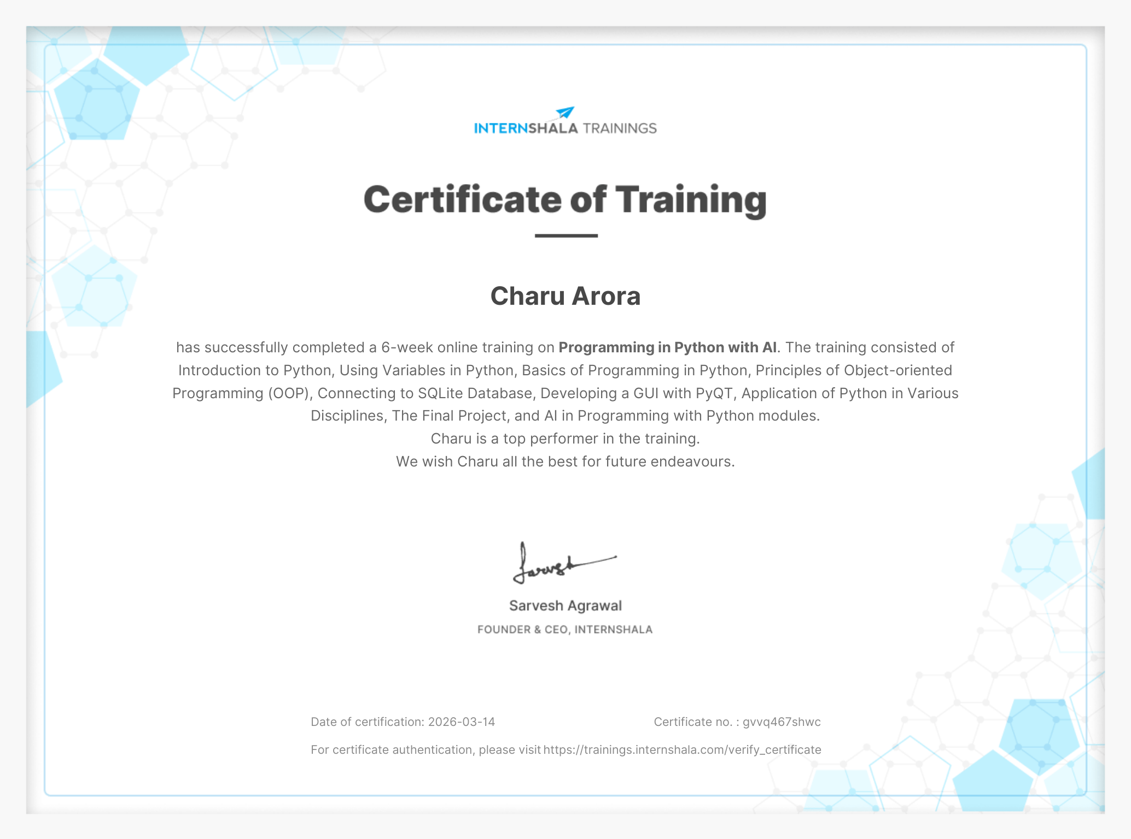
Your Certificate of Completion
9
Verified details from the uploaded certificate
Trainee
Charu Arora
Top performer
Certification
14 March 2026
6-week online training
Certificate No.
gvvq467shwc
CHARU ARORA • PROGRAMMING IN PYTHON WITH AI • IILM UNIVERSITY

Slide 10
Thank You!
Charu Arora
Roll No. 2410030544 • B.Tech (CSE) • Batch 2026–27
IILM University, Greater Noida, U.P.
PROGRAMMING IN PYTHON WITH AI

